Slide 1
Resources : Water
By:
m . rahul ram
r . Nithish kumar

Slide 2
CONTENTS
Introduction
Importance of Water Resource
Threats to Water Resource
Conservation of Water Resource
Conclusion

Slide 3
Water Resources
Water resources are natural resources of water that are potentially useful. Uses of water include agricultural, industrial, household, recreational and environmentalactivities. All living things require water to grow and reproduce.
97% of the water on the earth is salt water and only three percent is fresh water; slightly over two thirds of this is frozen in glaciers and polar ice caps.the remaining unfrozen freshwater is found mainly as groundwater, with only a small fraction present above ground or in the air.
Fresh water is a renewable resource, yet the world's supply of groundwater is steadily decreasing, with depletion occurring most prominently in asia, south america and north america, although it is still unclear how much natural renewal balances this usage, and whether ecosystems are threatened. the framework for allocating water resources to water users (where such a framework exists) is known as water rights.

Slide 4
Reservoirs of available water on earth
Reservoir | Volume(10^6 km^3) | Peecent of Total | Residence Time
Oceans | 1350 | 97.3 | 10^3 -10^4 yr
Glaciers | 29 | 2.1 | 10-1000yr
Aquifers | 8 | 0.6 | 2 weeks -10^4 yr
Lakes | 0.1 | 0.01 | 10 yr
Soil moisture | 0.1 | 0.01 | 52 days
Atmosphere | 0.013 | 0.001 | 10 days
Rivers | 0.002 | 0.0002 | 2 weeks
Biosphere | 0.001 | 0.0001 | 6 days

Slide 5
Importance of Water Reources
Agricultural Needs
Industrial Needs
Household Needs
Environmental Needs

Slide 6
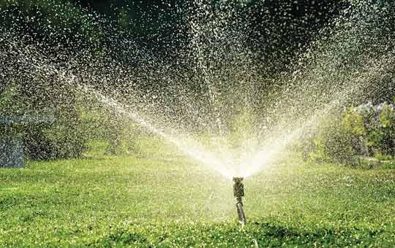
Agricultural Needs
It is estimated that 70% of worldwide water is used for irrigation.
It takes around 2,000 – 3,000 litres of water to produce enough food to satisfy one person's daily dietary .
To produce food for the now over 7 billion people who inhabit the planet today requires the water that would fill a canal ten metres deep, 100 metres wide and 2100 kilometres long.

Slide 7
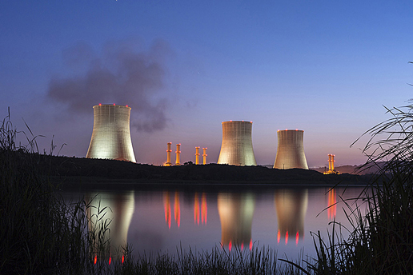
Industrial Needs
It is estimated that 22% of worldwide water is used in industry.
Major industrial users include hydroelectric dams, thermoelectric power plants, use water for cooling.
Ore and oil refineries, use water in chemical processes, and manufacturing plants, which use water as a solvent.
Water withdrawal can be very high for certain industries.
Consumption of water by industries is generally much lower than that of agriculture.

Slide 8
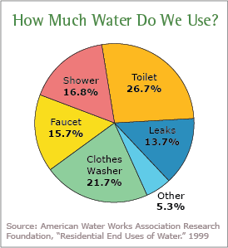
Household Needs
It is estimated that 8% of worldwide water use is for domestic purposes.
These include drinking water, bathing, cooking, toilet flushing, cleaning, laundry and gardening.
Basic domestic water requirements have been estimated by Peter Gleick at around 50 liters per person per day, excluding water for gardens.
Drinking water is water that is of sufficiently high quality so that it can be consumed or used without risk of immediate or long term harm. Such water is commonly called potable water.
In most developed countries, the water supplied to domestic, commerce and industry is all of drinking water standard even though only a very small proportion is actually consumed or used in food preparation.

Slide 9
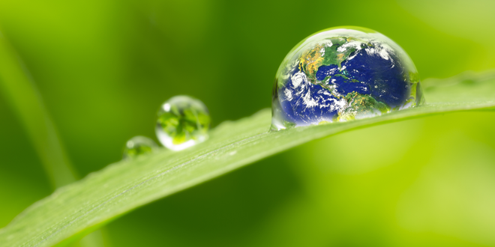
Environmental Needs
Explicit environment water use is also a very small but growing percentage of total water use.
Environmental water usage includes watering of natural or artificial wetlands, artificial lakes intended to create wildlife habitat, fish ladders, and water releases from reservoirs timed to help fish spawn, or to restore more natural flow regimes.
Environmental water may include water stored in impoundments and released for environmental purposes (held environmental water), but more often is water retained in waterways through regulatory limits of abstraction.

Slide 10
Threats to Water Resource
Population Growth
Water Pollution
Rapid Urbanisation
Depletion of Aquifers
Climate Change

Slide 11

Population Growth
In 2000, the world population was 6.2 billion. The UN estimates that by 2050 there will be an additional 3.5 billion people with most of the growth in developing countries that already suffer water stress.
Thus, water demand will increase unless there are corresponding increases in water conservation and recycling of this vital resource.
In building on the data presented here by the UN, the world bank goes on to explain that access to water for producing food will be one of the main challenges in the decades to come.

Slide 12
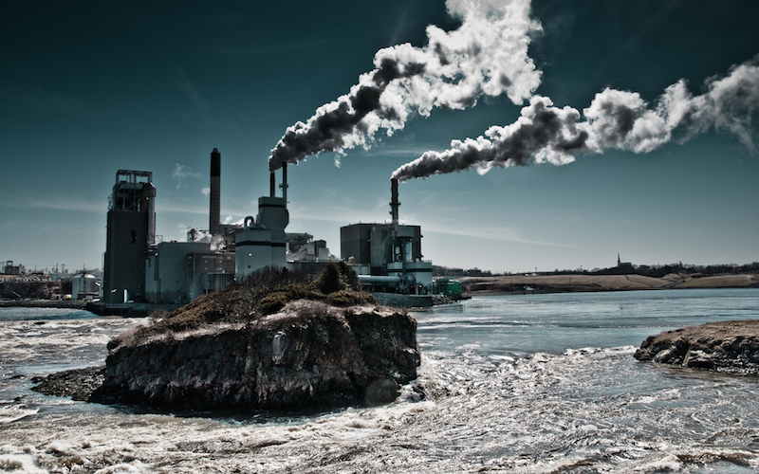
Water pollution
Water pollution is the contamination of water bodies, usually as a result of human activities. Water bodies includes lakes, rivers, oceans, aquifers and groundwater.
Water pollution results when contaminants are introduced into the natural environment. For example, releasing inadequately treated wastewater into natural water bodies can lead to degradation of aquatic ecosystems.
They may use the same polluted river water for drinking or bathing or irrigation. Water pollution is the leading worldwide cause of death and disease, e.g. Due to water-borne diseases.

Slide 13
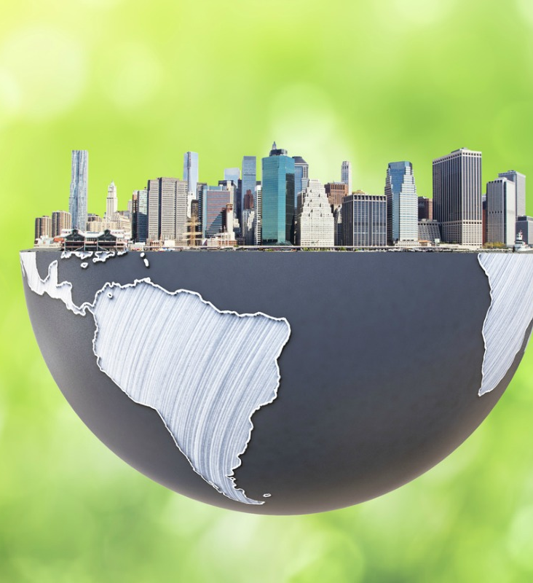
Rapid Urbanization
Urbanization-The process of becoming more like a city
The trend towards urbanization is accelerating. Small private wells and septic tanks that work well in low-density communities are not feasible within high-density urban areas.
Urbanization requires significant investment in water infrastructure in order to deliver water to individuals and to process the concentrations of wastewater – both from individuals and from business. These polluted and contaminated waters must be treated or they pose unacceptable public health risks.
In 60% of european cities with more than 100,000 people, groundwater is being used at a faster rate than it can be replenished, even if some water remains available, it costs increasingly more to capture it.

Slide 14
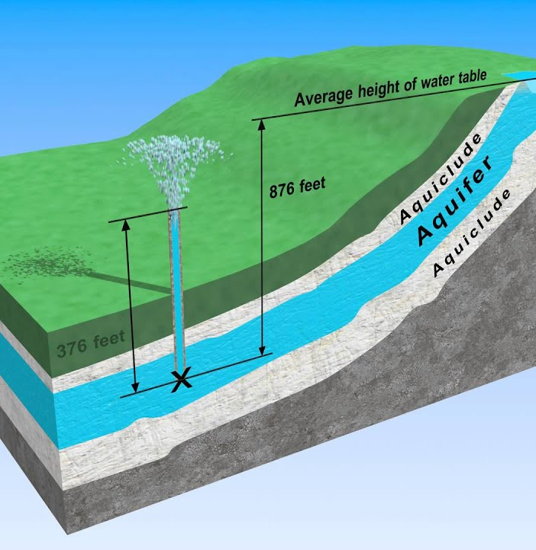
Depletion of Aquifers
Due to the expanding human population, competition for water is growing such that many of the world's major aquifers are becoming depleted.
This is due both for direct human consumption as well as agricultural irrigation by groundwater. Millions of pumps of all sizes are currently extracting groundwater throughout the world.
Irrigation in dry areas such as northern china, nepal and india is supplied by groundwater, and is being extracted at an unsustainable rate. Cities that have experienced aquifer drops between 10 and 50 meters include mexico city, bangkok, beijing, madras and shanghai.

Slide 15
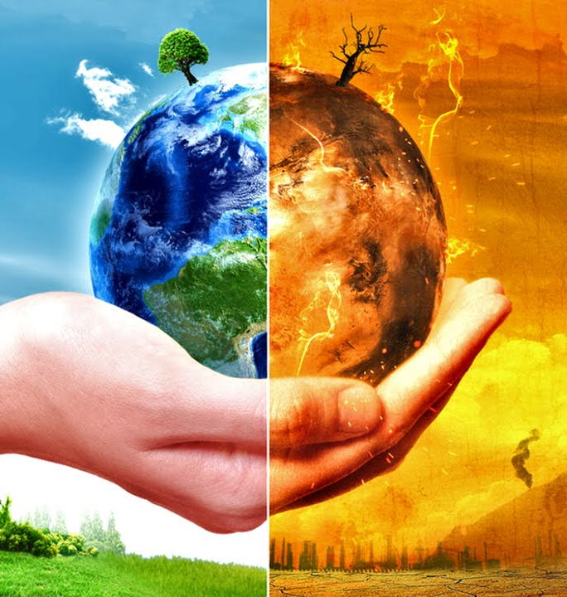
Climate change
Climate change could have significant impacts on water resources around the world because of the close connections between the climate and hydrological cycle.
Rising temperatures will increase evaporation and lead to increases in precipitation, though there will be regional variations in rainfall. Both droughts and floods may become more frequent in different regions at different times, and dramatic changes in snowfall and snow melt are expected in mountainous areas.
Higher temperatures will also affect water quality in various ways by enhancing eutrophication over lakes etc.

Slide 16
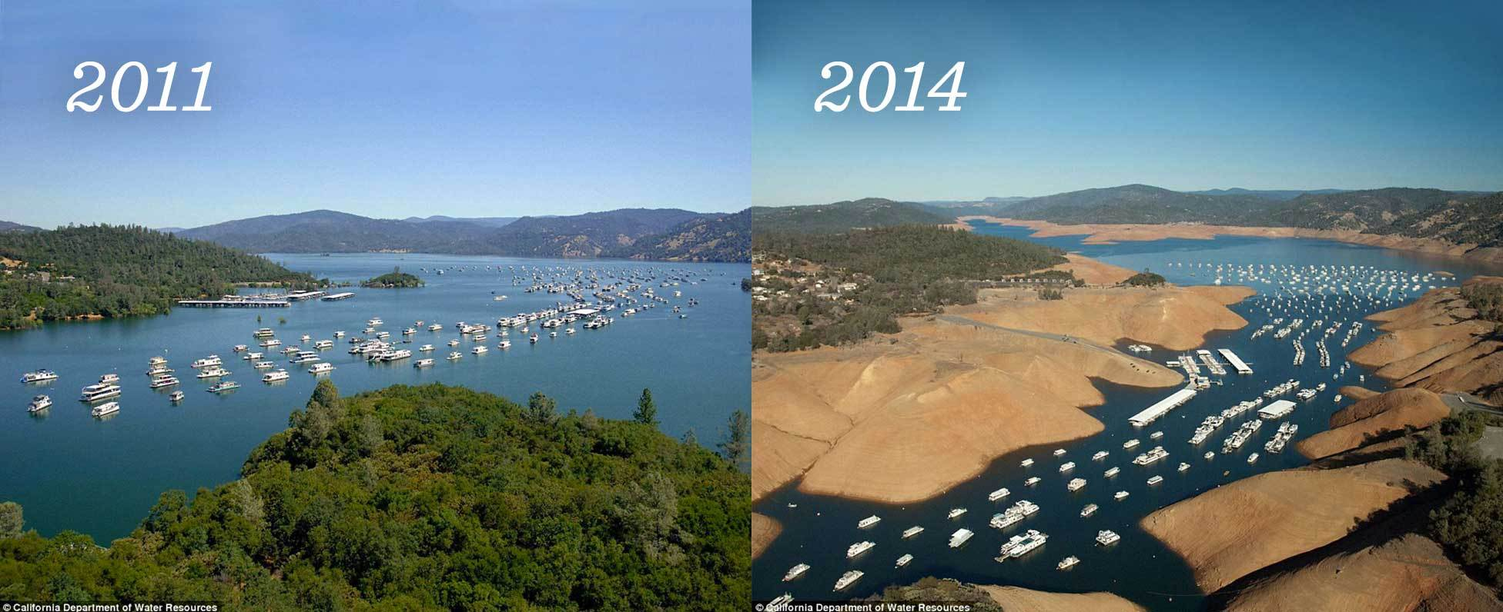
Aftermath of water depletion

Slide 17
Conservation of Water Resources
Social Solutions
Household Applications
Commercial Applications
Agricultural Application
Water Reuse
Rain Water Harvesting

Slide 18
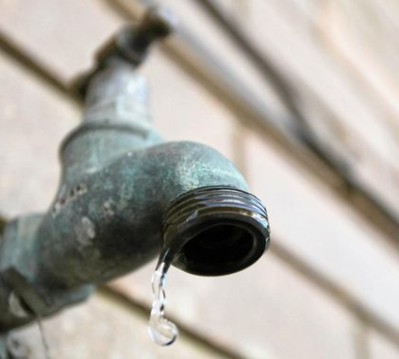
Social Solutions
Water conservation programs involved in social solutions are typically initiated at the local level, by either municipal water utilities or regional governments.
Common strategies includes :charging progressively higher prices as water use increases, restrictions on outdoor water use such as lawn watering and car washing.
Cities in dry climates often requires the installation of natural landscaping in new homes to reduce outdoor water usage.
Installing water recycling plants , will sufficiently reduce the water needs.

Slide 19
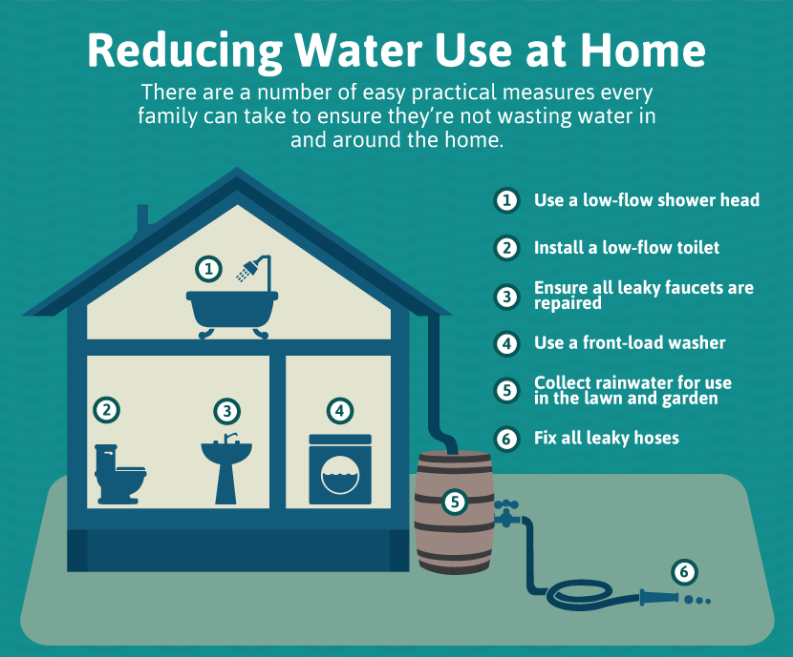
Household Applications
Don’t seal the ground completely, allow penetration of water through the soil.
Use the right amount of water for each load of laundry.
Pick your washing machine wisely.
Water plants wisel.
Check for and repair leaks.
Use a dishwasher..
Turn off the tap properly , when it is not needed.
Manage outdoor water use.

Slide 20
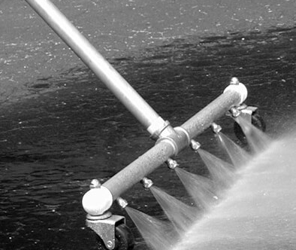
Commercial Applications
Water-saving technology for businesses includes:
Waterless car washes
Infrared or foot-operated taps, which can save water by using short bursts of water for rinsing in a kitchen or bathroom
Pressurized waterbrooms, which can be used instead of a hose to clean sidewalks
Cooling tower conductivity controllers
Water-saving steam sterilizers, for use in hospitals and health care facilities
Rain water harvesting

Slide 21
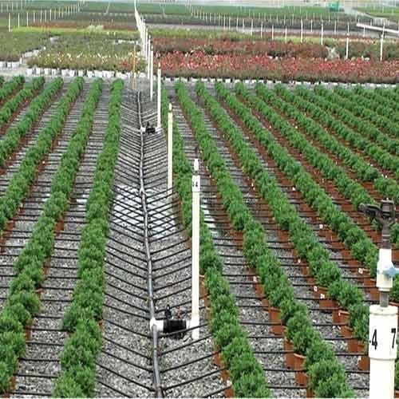
Agricultural Application
Drip Irrigation-water to drip slowly in the roots of the plants
Capturing and Storing Water – that can be used while droughts.
Proper Irrigation Scheduling – for the efficient use of water .
Drought –Tolerant Crops –eg:sorghum,millets,grean pea,etc
Dry Farming
Rotational Grazing
Going Organic

Slide 22
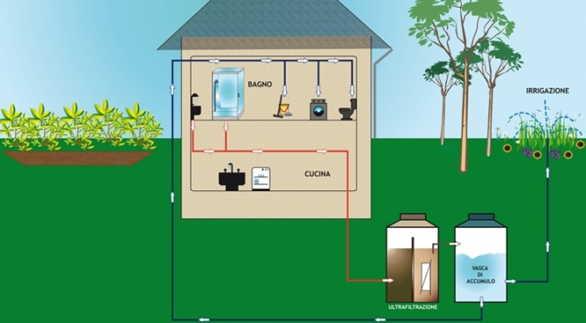
Water Reuse
By using waste water as a resource rather than a waste product you can:
Reduce water bills
Use fewer water resources
Irrigate the garden during drought of water restrictions.
Cut down the amount of pollution going to the waterways.
Help save money on new infrastructure for water supplies and waste water treatment.

Slide 23
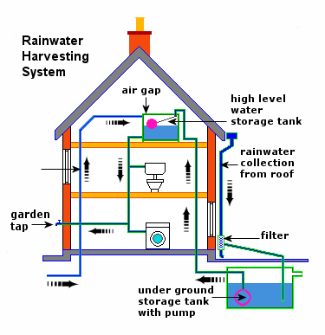
Rain Water Harvesting
Solution to water crisis
2.Sustainable, participatory, equitable management of water
3. To inculcate a culture of water conservation
4. To reduce soil erosion
5. To conserve surface water runoff during monsoon
6. To beneficiate water quality in aquifers
7. To arrest ground water decline
8. To augment ground water table
9. Collection of water for irrigation
10. Concious storage of water for domestic purposes

Slide 24
Conclusion
We are fortunate enough to live in a place where free water flows free on demand,it can be easy to use it for granted. From our daily dishwashing routine to your daily shower,Every drop of this natural resource is precious,practising conservation not only good for the environment,but can save your money in energy bills.
“To a thirsty man a drop of water is worth more than a sack of gold”
Save water!!!!!!

Slide 25

Thank you

